Slide 1
Analysis of Financial Returns
Presented by:
Ritz Chaudhury
Villie Joe Gorra
Nandan Soni
December 19, 2024

Slide 2
Land Acknowledgement
Okanagan College would like to recognize and acknowledge the traditional, ancestral, and unceded territories of the Syilx, Secwépemc, Ktunaxa, and Sinixt Okanagan People. It is on these lands where we live, learn, collaborate and work together.

Slide 3






The dataset
Date M2V UNRATE
CPIAUCNS PPIACO FEDFUNDS

Slide 4






The dataset
Adj.Close GOLD WTISPLC (Crude Oil)
PERMIT.Units Cluster DXY (USD Index)

Slide 5
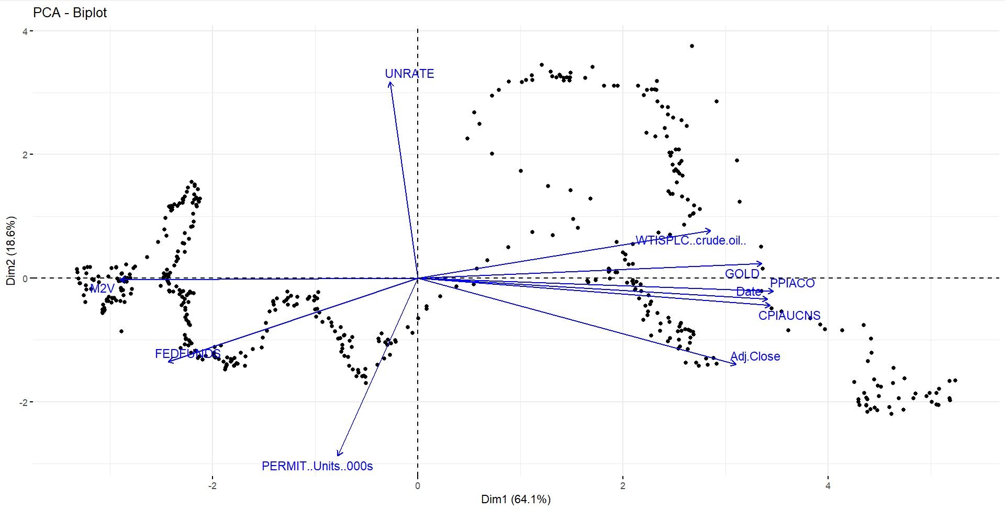

Slide 6
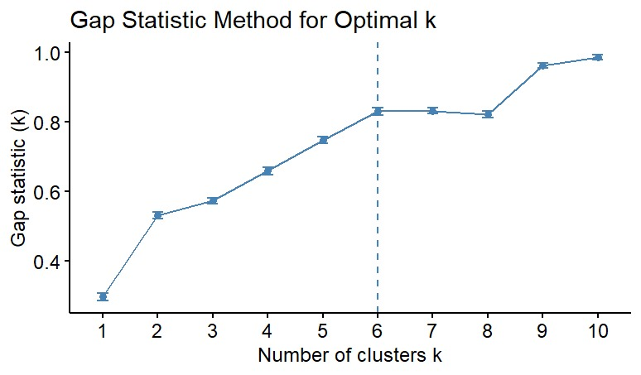

Slide 7
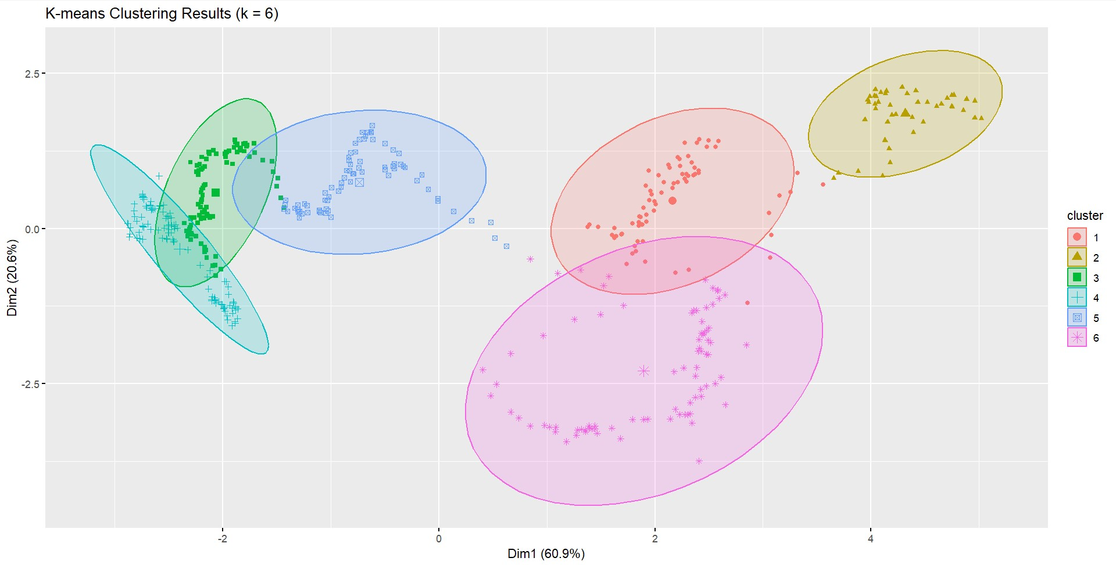

Slide 8
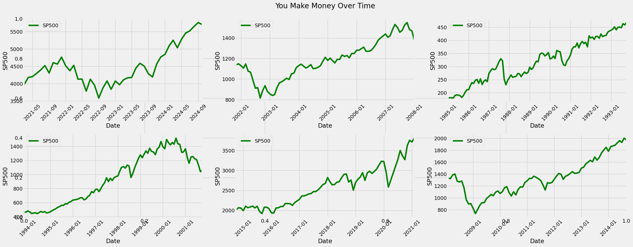
Market Cycle Lasts Between 6 Years 3 Months to 6 Years 4 Months

Slide 9
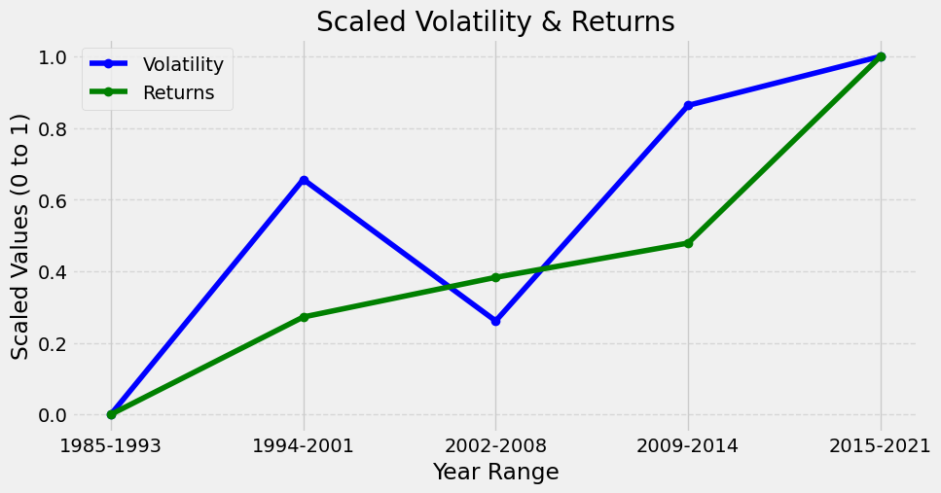

Slide 10
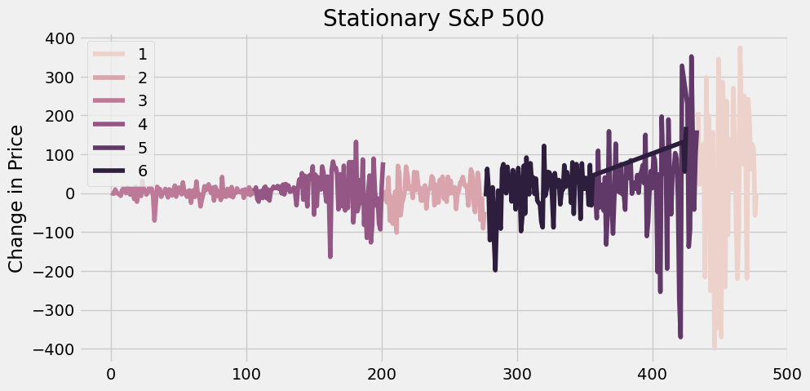

Slide 11
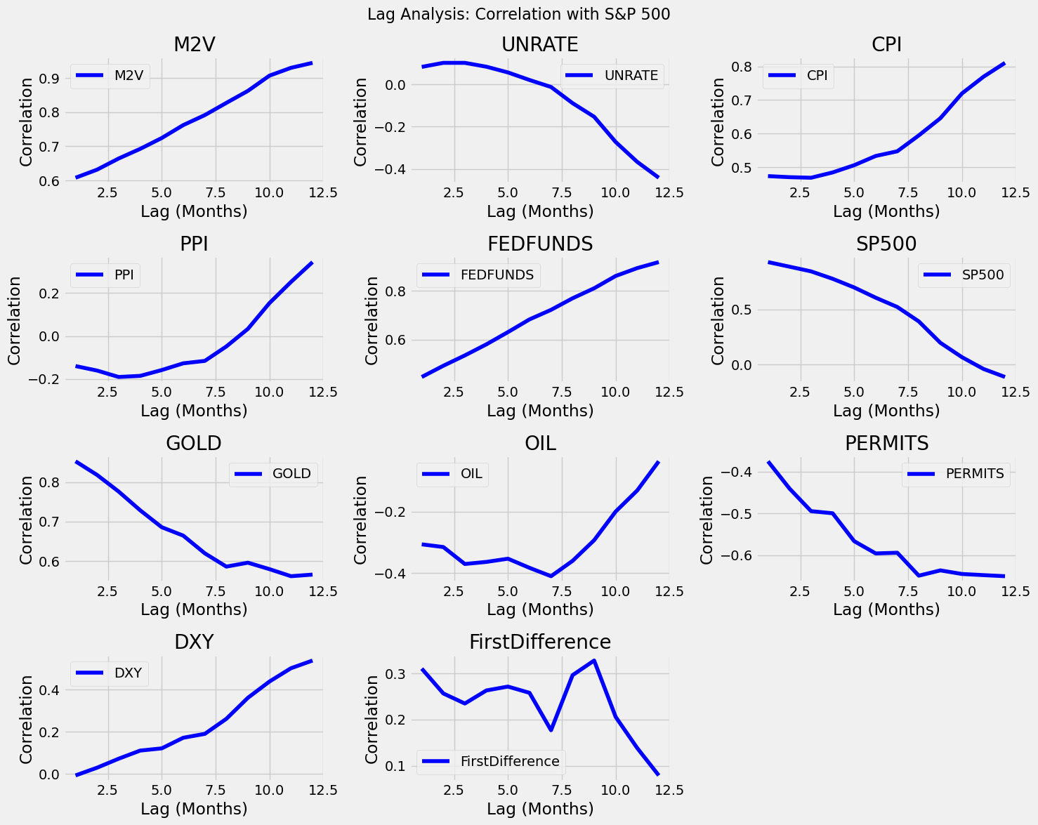
Different Lags

Slide 12
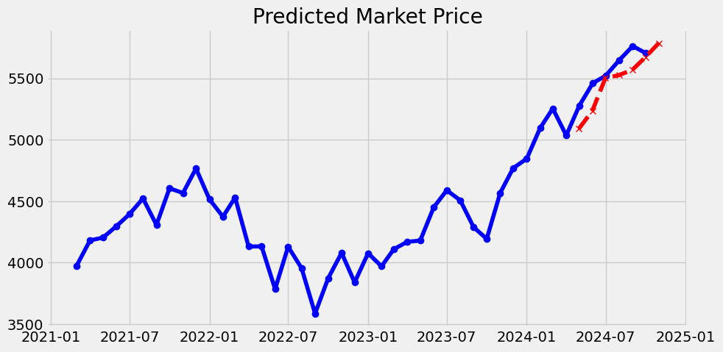
Prediction Interval 5964.475 5610.685

Slide 13
The Best Parameters
No. of layers | Layer 1 Neurons | Layer 2 Neurons | Layer 3 Neurons | Layer 4 Neurons | Layer 5 Neurons | Epochs | Learning Rate
5 | 64 | 72 | 112 | 40 | 8 | 65 | 0.007592
The average model loss is 4117.105 to 4470.895 at 95% C.I
R-Square Initial = 0.63
R-Square Final = 0.88

Slide 14
Model Risk
There might be other data that could be considered
We don’t have political data

Slide 15
Wrapping Up
Bullish Market
Lower Risk to Reward Ratio
Model Valid Till Middle Of 2026

Slide 16
Thank you!

